Slide 1
CNN based Image Scene Classification
Paul Bauriegel, Oliver Faber, Daniel Pavicic, Markus van Ballegooy

Slide 2
Mission
Build a classifier that can distinguish images in different categories.
The output of the system can be an input to the other modules in an image processing system.

Slide 3
Approach
Data Cleaning and Preprocessing
Experiments with statistical Classifiers:
Feature Extraction from vgg16 + SVC
“Simple” RGB -Features + xxx Classifier
Experiments with CNN:
Train new model from Scratch
Use pretrained model
Select best classification model

Slide 4
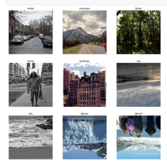
Data
Intel Image Classification Set
25.000 Images (150 * 150)
6 Categories
buildings , forest glacier , mountain , sea , street
3 subsets (Train, Validation, Prediction)
https://www.kaggle.com/puneet6060/intel-image-classification/version/2

Slide 5
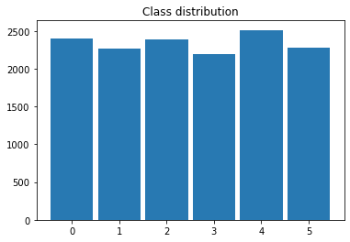
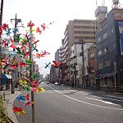
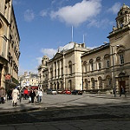
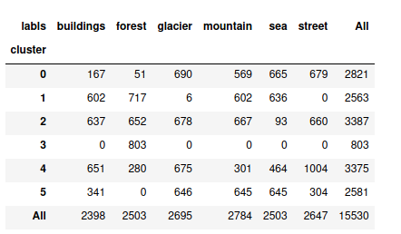
Data Preprocessing
same size for all pictures (150*150)
pictures evenly distributed over classes
mislabeled images in training set
wrong category
multiple category (eg. street or building)
“no match” category
Check:
→ re - clustering over 4096 vgg16 features
k-means clustering

Slide 6
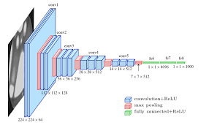
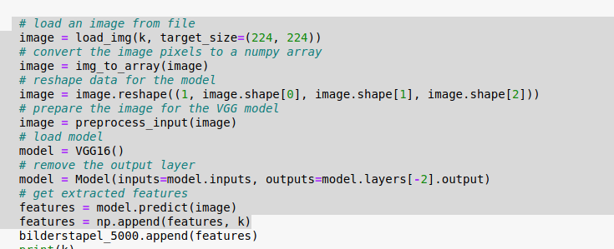
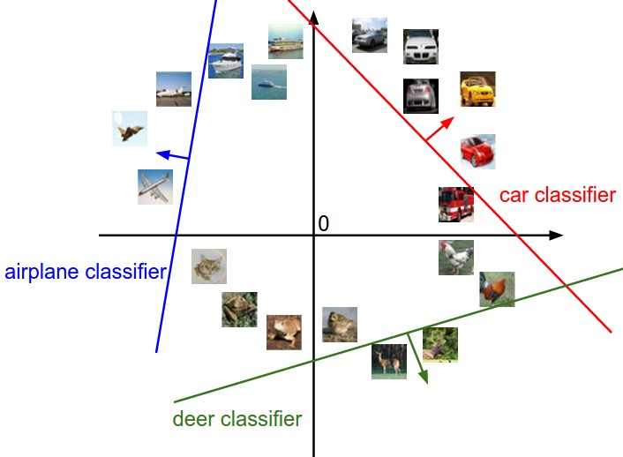
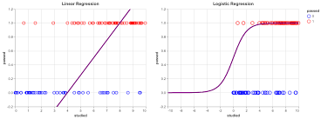
Statistical Classifier
feature extraction with vgg16 (-2 layers)
take model predictions as features (4096 per image)
feed feature vectors into classifiers
SVM Classifier
Logistic Regression
Accuracy Scores :
SVM : 91.08
LogReg : 91.24
SVM : 91.08% LogReg : 91.24%4

